Slide 1
The Art & Science of Tendering
Sander Vaneker, Contracting at Belastingdienst
Paul Maatman, Marketing & Tendering at B-Waste
Enschede, 20 september 2019

Slide 2
Why are we here TODAY?
Sander: Tendering perspective “AANBESTEDENDE DIENST/CONTRACTING AUTHORITY/BUYER”. Leentje Volker named it last week: CLIENT.
Experience: lots of Tender-experience at Gemeente Hengelo, Buurtzorg Nederland (Healthcare), Belastingdienst (Tax-authorities)
Paul: Tendering perspective “INSCHRIJVER/SUPPLIER/SELLER”. Leentje Volker named it last week: AANNEMER/OPDRACHTNEMER/CONTRACTER.
Experience: lots of Tender-expercience at B-Waste (Waste processing systems)
Our main goals today: to show you what you can accomplish with (excellent) Tenderskills on both sides playing field. Seduce you into a carreer in Tendering?

Slide 3
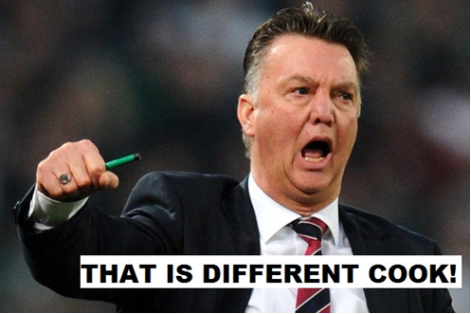
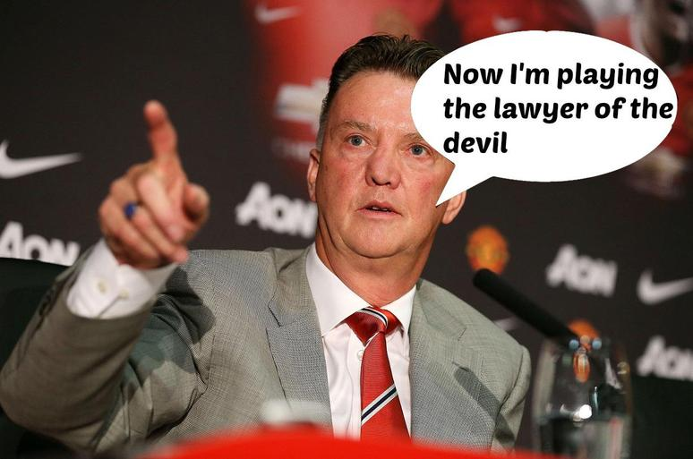
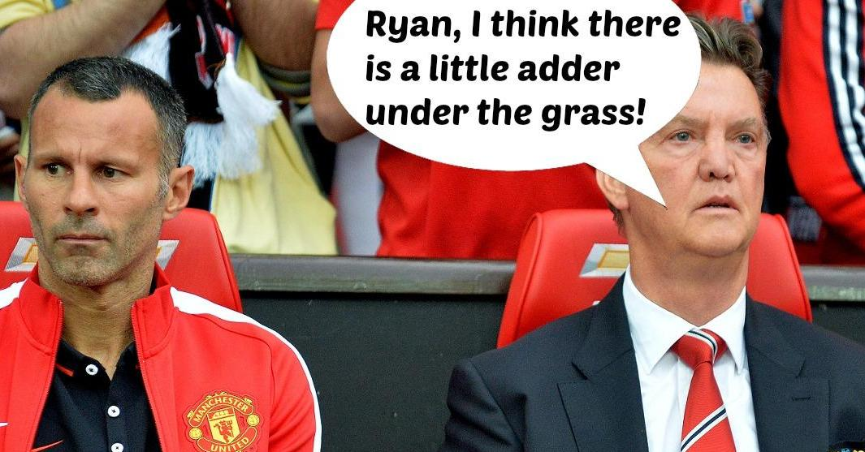
Sorry in advance for “Louis van Gaal-English”

Slide 4
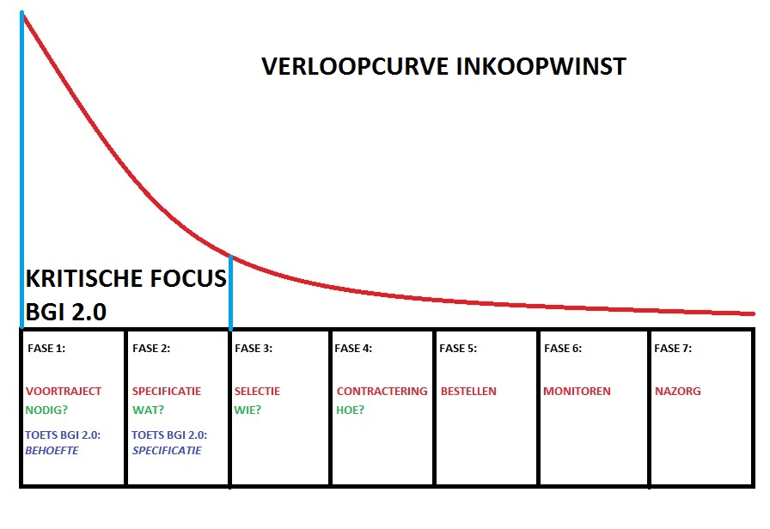
Tendering: First 4 stages of Purchasing proces (COMBI: J. Telgen/S. Vaneker 2016)

Slide 5
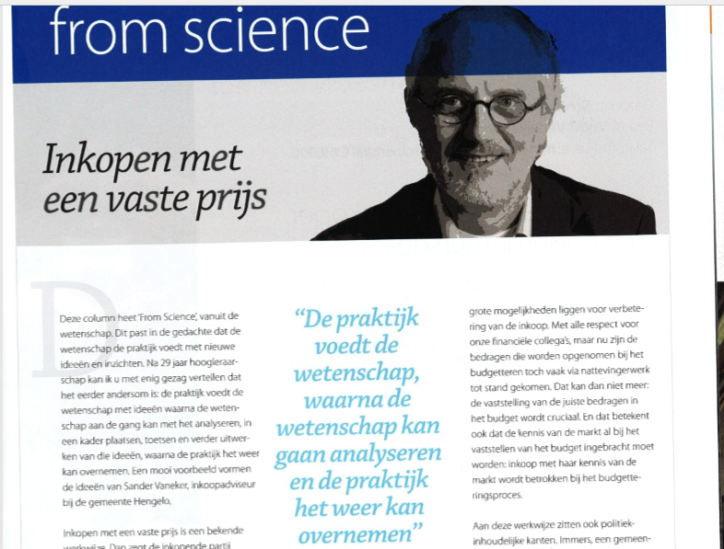
Please Read the article: Buying at a Fixed Price
DEAL 1 JANUARY 2016

Slide 6
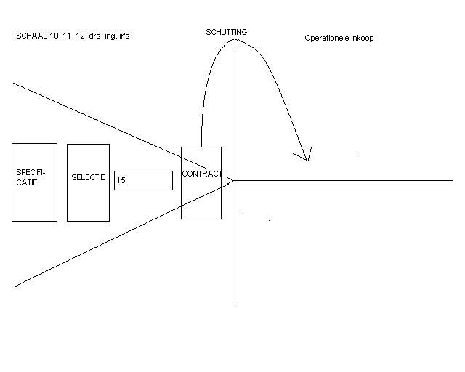
CONTRACTmanagement: LAST 3 stages of Purchasing proces….THE FENCE (A. Goldman 2006)
,

Slide 7
Stage 1 demand: do we really need it?
The easiest Stage, but the most forgotten (added later in the model)
Focus: do we really need it?
You can perform a Purchasing Proces excellent for something you don’t need
Students might think: that will not happen. Please wake up: it does…
Bridges that are not used
Products that are available in other departments of an organization
We buy too much: better safe than sorry
Hobby-buying: IT-professionals are very fanatic in specifying (the-only-way-is-up-principle)
Not-buying or less buying (quality or numbers) could be the the best Procurement decission after this stage
Just keep in mind but Procurement is too much fun to end it here, so let’s buy!

Slide 8
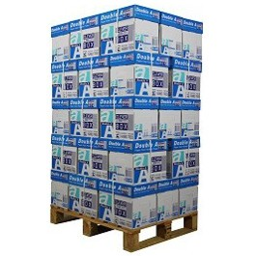
Stage 2 Specifying: My first “little” Tender (even simple copy paper can be complex)
2006: the tendering of ... A4 Print & Copy Paper… (5 Contracting Authorities)
Spend yearly 50K (5 CA’s 250K)

Slide 9
A lot of collegues wantED to specify the Needs:
Financial Management: commodity good so as cheap as possible (maybe profit?)
Facility Management: no problems with the copy machines
The Archives: quality should at least be guaranteed for 200years….
Sustainability management: the least grammes and as grey as possible (PR)
Communications: thick paper and as white as possible (also PR….)
Purchasing (me): according to tender-law: European Tender Procedure
The Jurists: no interpretation problems: specifications as Black/White possible
Owner of Paper budget: Does not like the European Procedure: too bureaucratic
Owner of Paper budget: our own 50K is low enough for 3-on-1 procedure
Board of collaboration 5 City’s: More Volume, Better Price.
The other 4 City’s: different specifications on certain demands!
Summary: conflict of interests

Slide 10
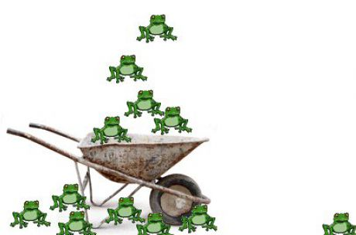
My biggest Challenge in this Little Tender:

Slide 11
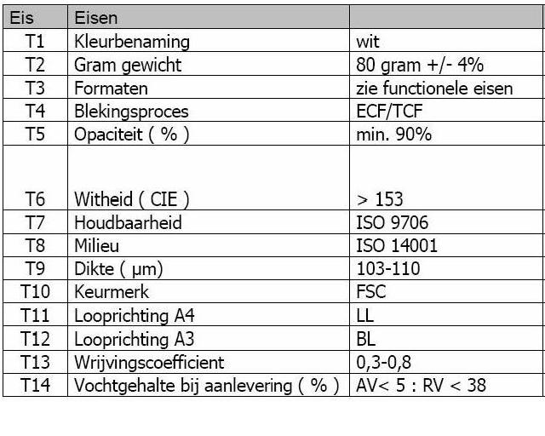
The results of the specification stage:

Slide 12
Main Results of this paper Tender
The good news was: we got our paper according to the specs.
There was a little big issue: 1 supplier offered a very very good price but their weight tolerance was too high: +/- 4 GRAMMES (they did not read the specs well enough): KNOCK-OUT
Some stakeholders: Purchasing should not be “More Catholic than te Pope”…
The bad news was: Purchasing (me) got an headache during the process.
I cryed out loud several times: “ITS ONLY COPYPAPER MY FRIENDS”.
But in the end: very good subject to learn what Tendering is all about.

Slide 13
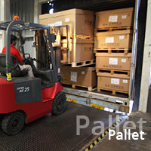
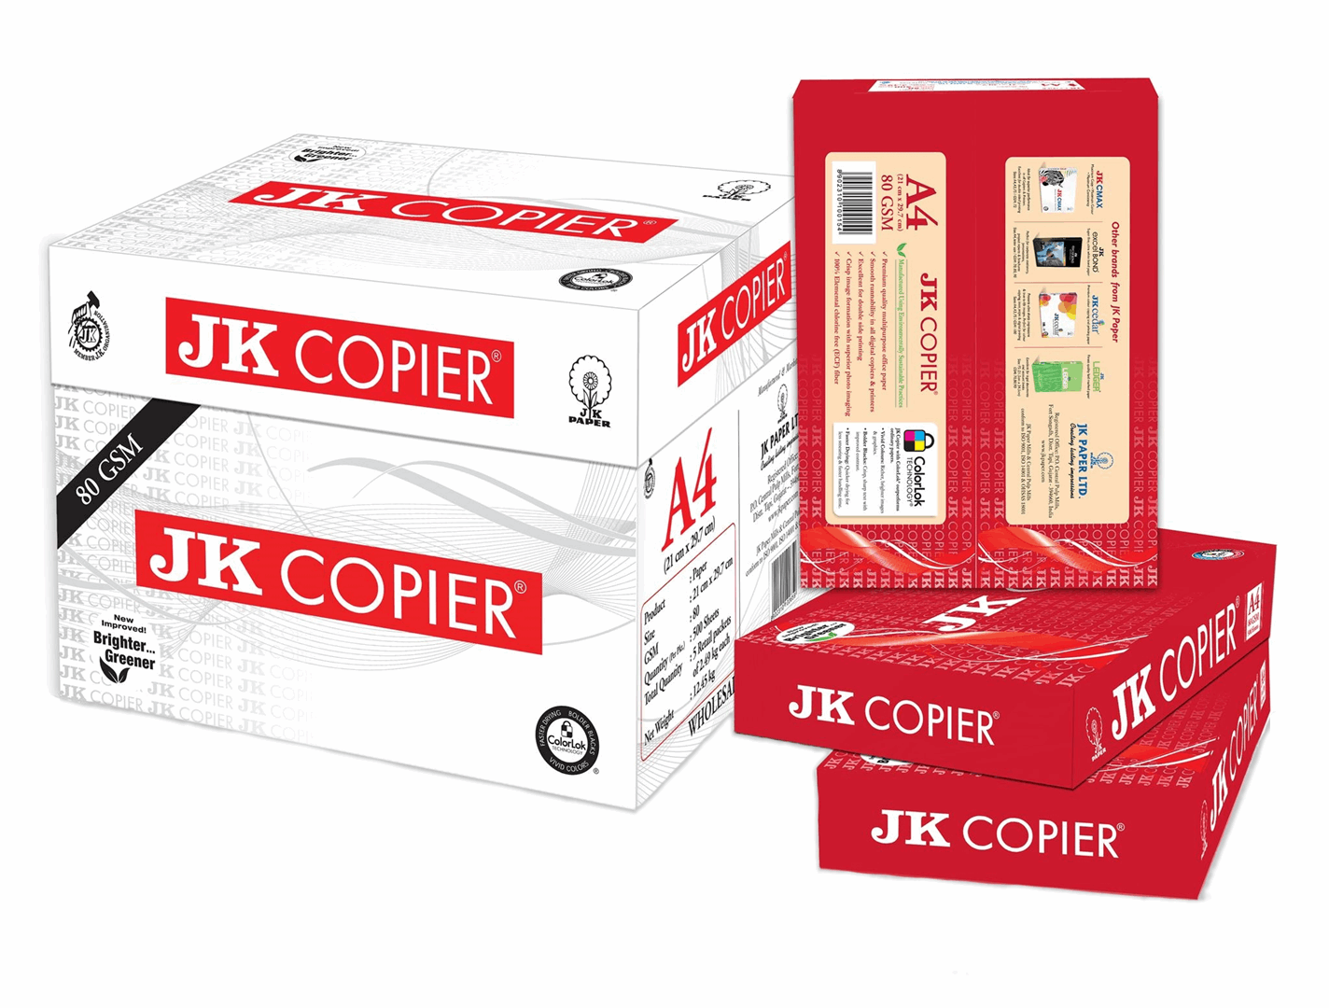
After the ink on the contract was dry we found out 2 major –not specified- problems
Delivery Pallets too big for elevators: Boxes and covers very important:

Slide 14
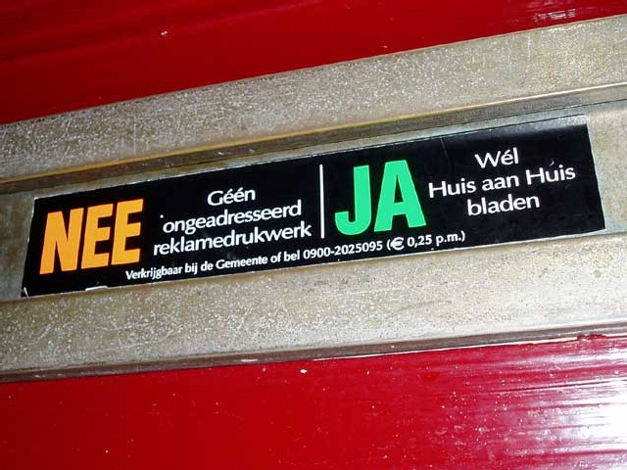
Stage 3 selecting: My first “every supplier will get his chance, but we only want…..”
2009: the tendering of ...Huis aan Huis Advertentieruimte…(Advertorial space in the local newspaper for legal announcements of the City)
Spend yearly 100K

Slide 15
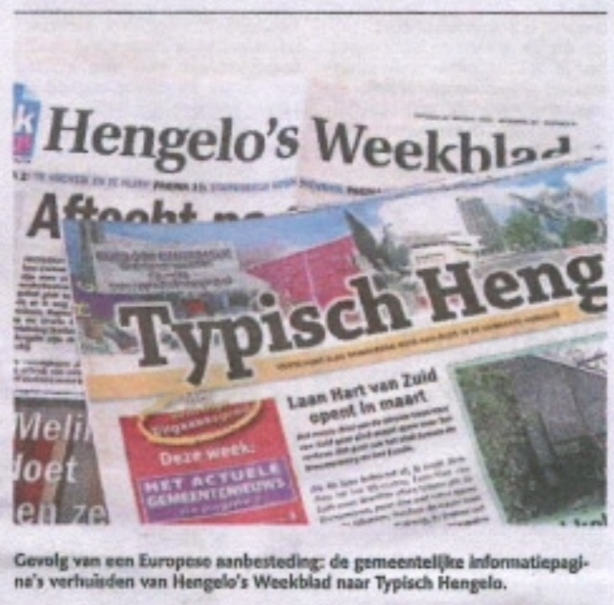
Buying impuls: the accountant
Yearly spend 100K without any (written and signed) contract
Accountant: this needs to be EU-tendered because past 4 years spend was >210K
This type of contracts is off course very local, but still EU wants it in open market…
For years and years it was “Hengelos” who did the job…
But now a new company wanted to get a market share: “Typisch”
They already wrote a few letters to the board: when will we get a chance?
Now this was the moment:

Slide 16
Very good contract, nobody happy
We started a competition between “Typisch” and “Wegener”
In our perspective a EU-tender would not make any sense…only 2 possible…
“Typisch” won the tender, very good price, very good (written) quality
Costs were sunk 50%
But everybody was in shock starting with the board, followed by management
So many years of partnership, “Wegener” sponsored an important sportsevent…
The question was asked: what can we do to award the Tender to “Wegener”
A well known Tender Lawyer was hired and his advice: it should have been EU ☺
So we started the EU-Tender, a Tender-advice company was hired….(25K)
And the winner was……: “Typisch”, at even a better price.
Everybody accepted it but no one was really happy.

Slide 17
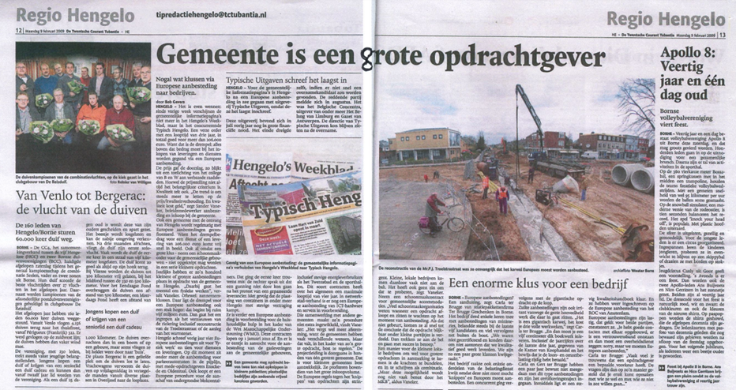
Really nobody happy? Maybe just me a little bit!

Slide 18
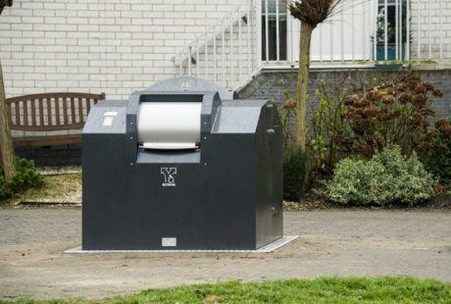
Stage 3 Contracting: Dear Supplier, we tell you in detail what you will have to deliver…
2010: the tendering of ... Waste Containers (underground), Twente Milieu and several cities…

Slide 19
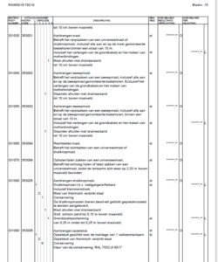
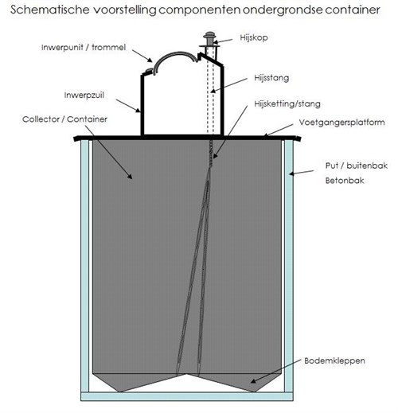
At that time: technical specifications
Most of the preparation time was spend on detailled technical specs
Size, material, numbers, operating systems, maintenance, service, etc.
Everything completely written out till behind the , in a “bestek” (information document and drawings)

Slide 20
What happened?
Suppliers wanted to give advice, but there was not enough time in the procedure
All suppliers offered a container not 100% conform specs.
It was more or less impossible to award honestly
Lawyers were needed to make a breakthrough in the Tender process
On both sides: Aanbestedende Dienst en Leveranciers
B-Waste (Paul was not yet working there) was the winner in the end
But Louis van Gaal would say: “everybody had a nasty taste on the side”
And that is why in 2018 Rotterdam (together with Twente Milieu en Twente Cities) started a new tender in a more modern cooperation seeking way:
Paul was part of the Tenderteam of B-Waste and will tell you the results of this:
COMPETETIVE DIALOGUE

